Slide 1
COMPUTATIONAL METHODS FOR PRECISION SIGNAL SYNTHESIS IN QUANTUM SENSING SUBSYSTEMS
Under Supervision of
Prof.(Dr.) Indrajit De And Dr. Aishik Acharya
By:
Anumoy Pathak
Jayabrota Banerjee

Slide 2
Introduction
Cold atom interferometry (CAI) represents a frontier in precision measurement technology, enabling direct observation of gravitational acceleration, rotations, and fundamental constants with quantum-limited accuracy.
At the heart of a cold atom interferometer, typically involve a combination of Raman or Bragg laser pulses that coherently split, redirect, and recombine the atomic wave packets.
Therefore, precise control of multiple laser beams, frequency references, and timing signals is an essential engineering challenge in such experiments.
To address this, a custom-built embedded control system has been developed, designed around an STM32 microcontroller, a Direct Digital Synthesizer (DDS), and an FPGA-based Phase- Comparator.

Slide 3
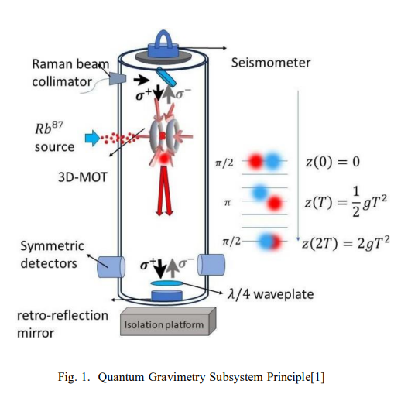
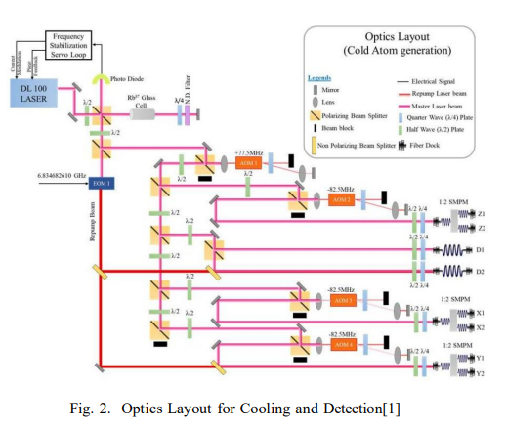
Quantum gravimeter subsystem prepared by TCG CREST

Slide 4
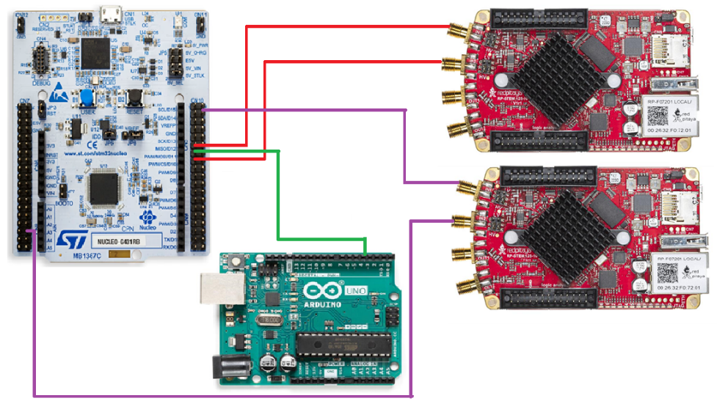
Signal generation using STM32 G431RB for multiple pulse control

Slide 5
Signal generation using STM32 G431RB for multiple pulse control
The STM32G4 Nucleo-64 boards based on the MB1367 reference board (NUCLEO-G431RB, NUCLEO-G474RE, NUCLEO-G491RE) provide an affordable and flexible way for users to try out new concepts and build prototypes with the STM32G4 series microcontrollers,
choosing from the various combinations of performance, power consumption, and features. Our system consists of an STM32G431RB microcontroller responsible for generating four independent digital control signals used to operate beam shutters. Each signal can be programmed with specific parameters including delay, pulse width, polarity, and enable status. The control signals are synchronized with an external trigger pulse generated by an Arduino board. The entire setup is tested and validated using a Red Pitaya, which provides real-time visualization and waveform analysis.

Slide 6
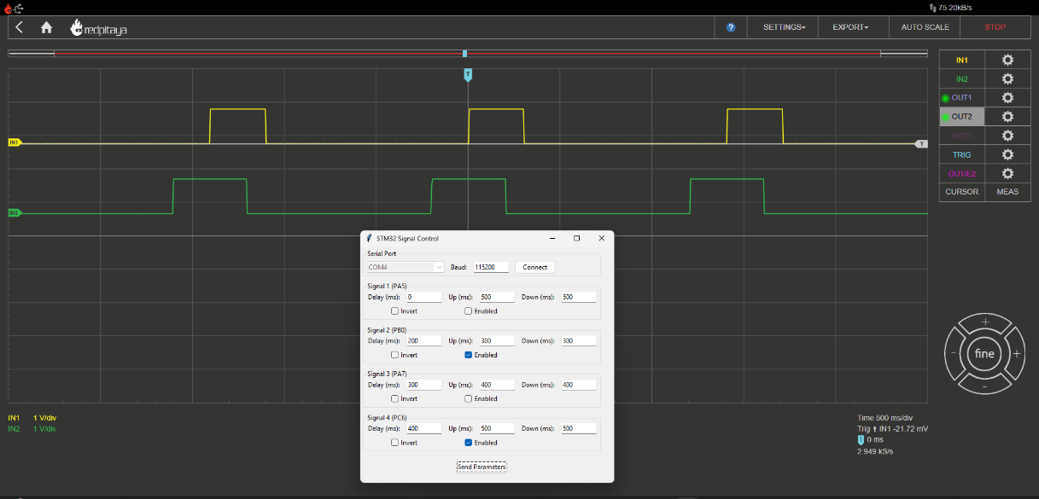
Signal generation using STM32 G431RB for multiple pulse control

Slide 7
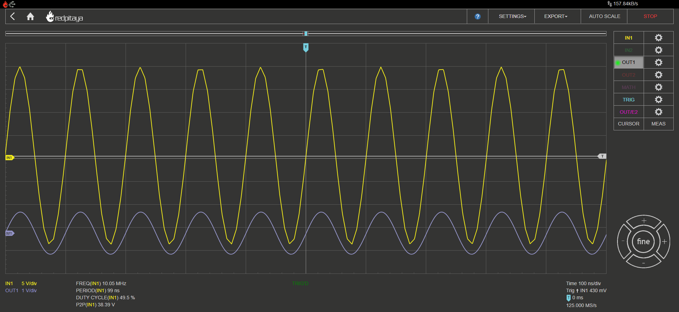
Waveform triggered by DDS

Slide 8
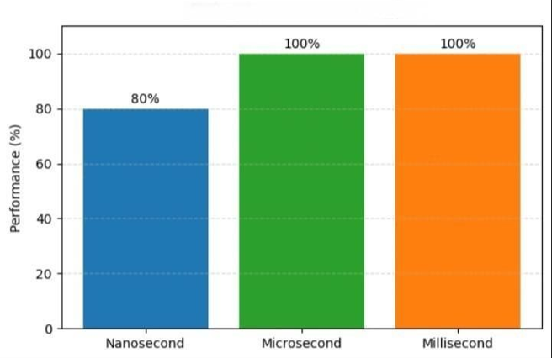
Result Accuracy
Timing Precision Graph

Slide 9
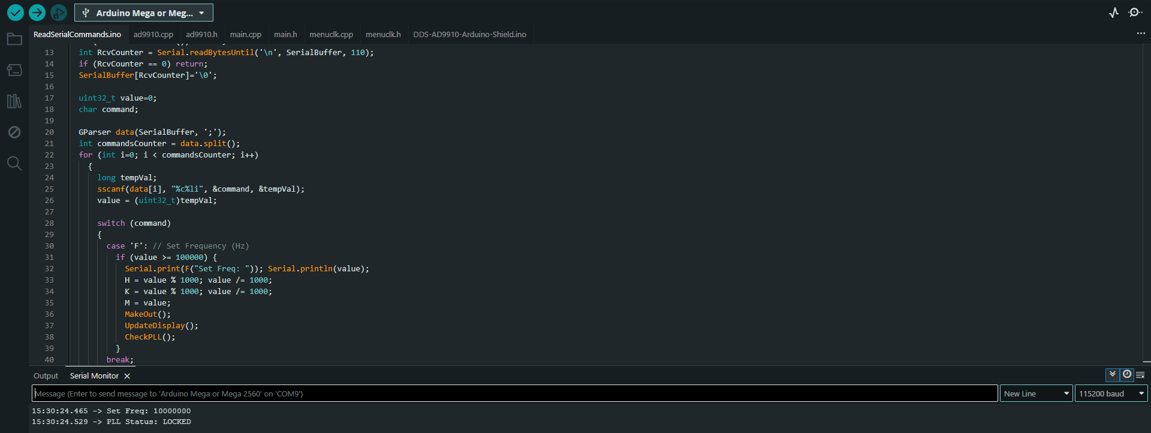
DDS code for PLL locking on FPGA

Slide 10
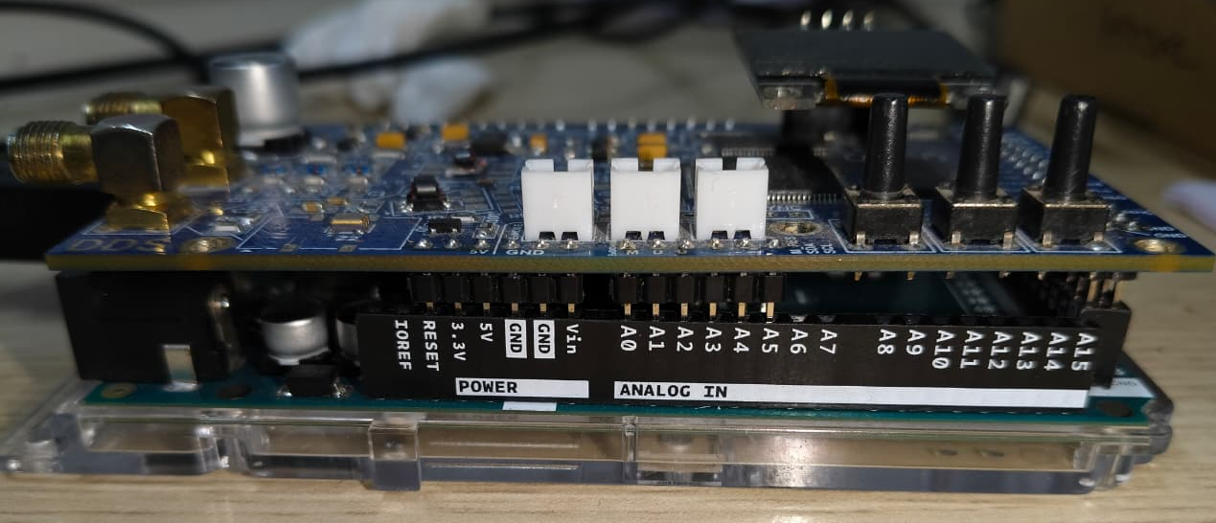
Signal generation using DDS to simulate laser

Slide 11
Signal generation using DDS to simulate laser
In quantum gravimetry experiments based on cold atom interferometry, precisely controlled laser frequencies are essential for manipulating atomic states through Raman or Bragg transitions. The Direct Digital Synthesizer (DDS) offers an excellent solution by providing fine frequency, phase, and amplitude control with high spectral purity and fast switching capability.
In this setup, the Arduino Mega 2560 is used as the control interface for the AD9910 DDS, enabling digital programming of frequency tuning words, phase offsets, and profile registers via the SPI communication protocol.

Slide 12
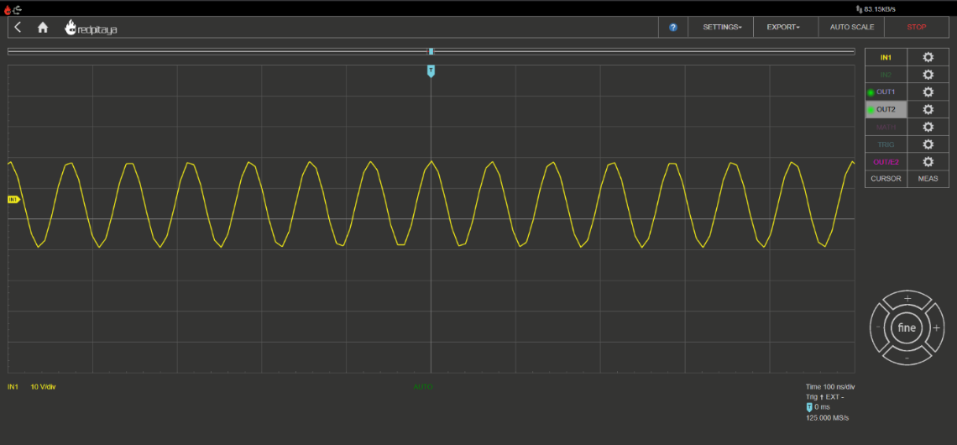
Signal generation using DDS to simulate laser

Slide 13
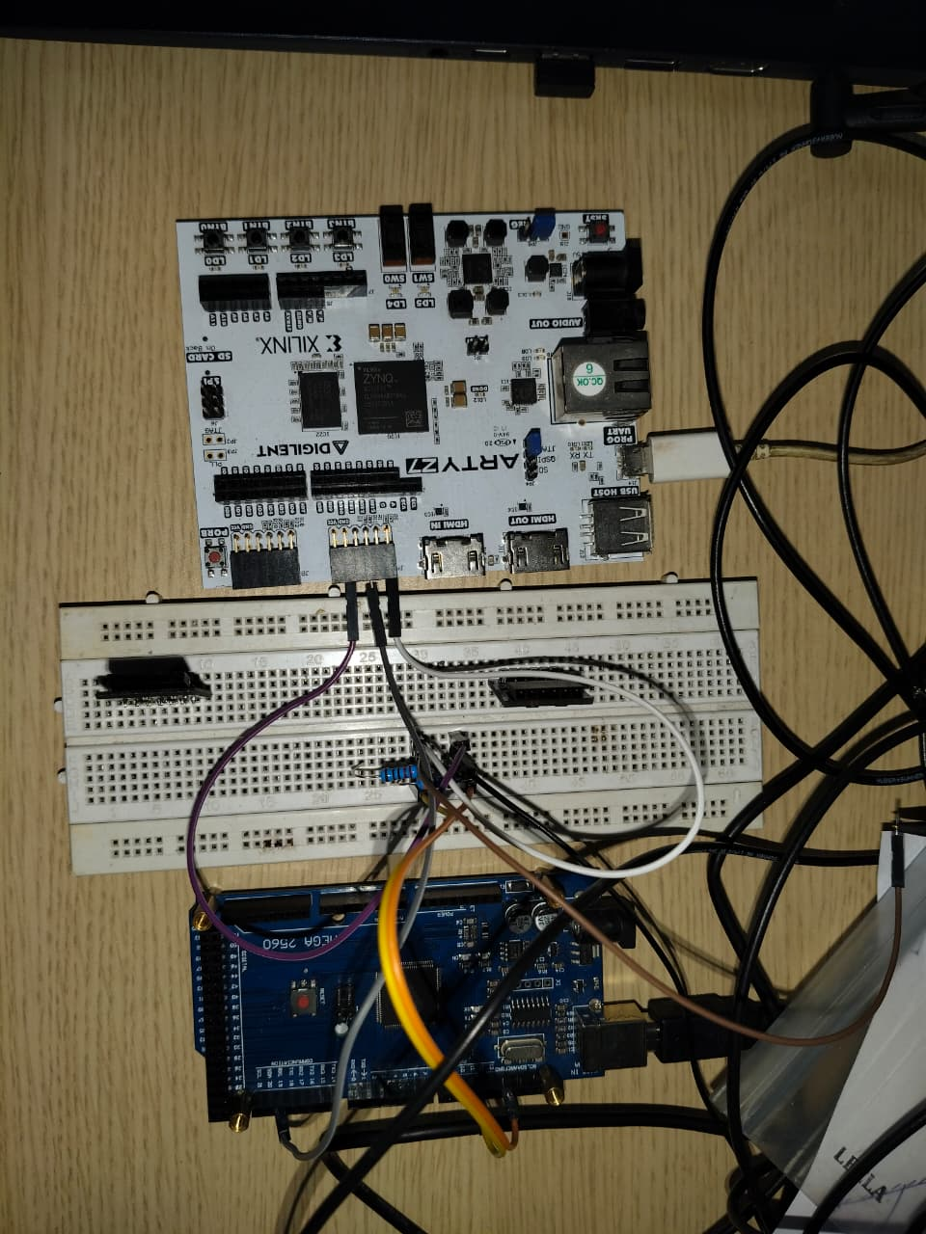
Signal generation using FPGA to make a Phase Comparator

Slide 14
Signal generation using FPGA to make a Phase Comparator
Quantum gravimetry relies on the precise control and synchronization of electromagnetic signals that drive laser-based atom interferometers. Accurate phase coherence between reference and experimental signals is critical for detecting the minute phase shifts induced by gravitational acceleration on cold atoms. To achieve this level of control, stable frequency generation and precise phase comparison hardware are essential.
In this project, a Field-Programmable Gate Array (FPGA) is employed to generate a reference frequency derived from its internal 125 MHz system clock.

Slide 15
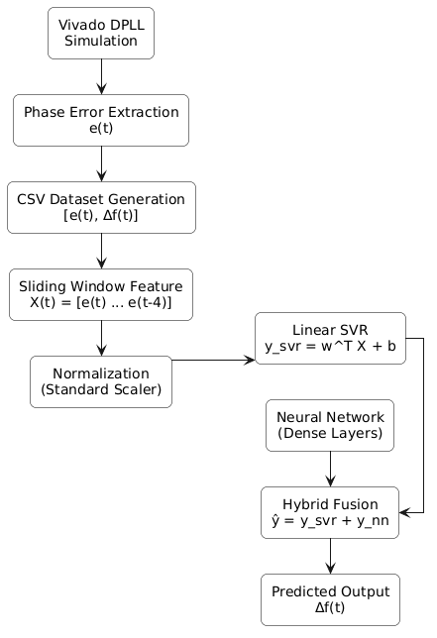
Proposed Methodology

Slide 16
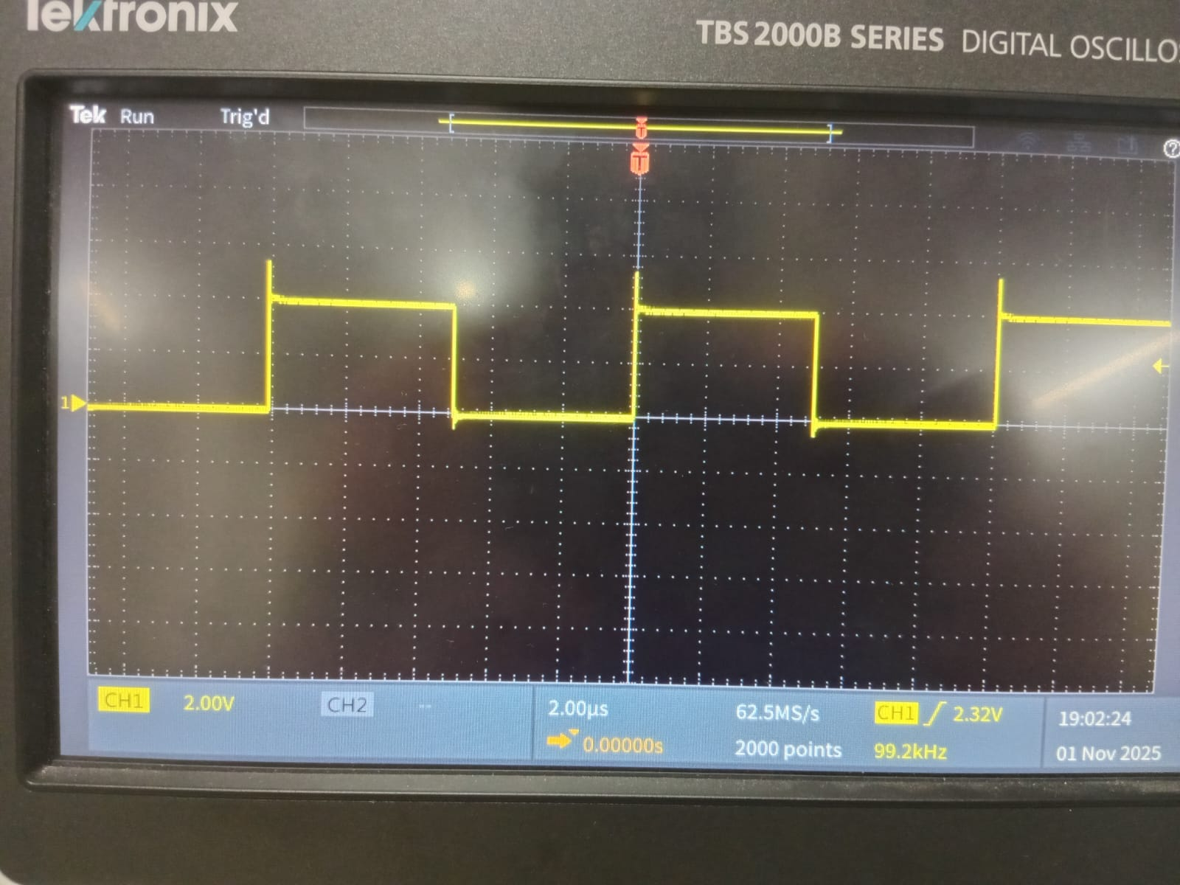
Signal generation using FPGA to make a Phase Comparator

Slide 17
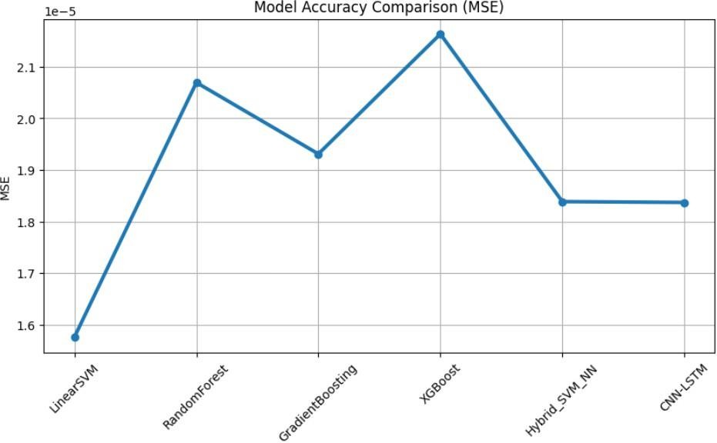
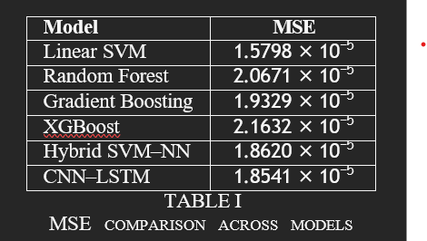
Results & Discussion

Slide 18
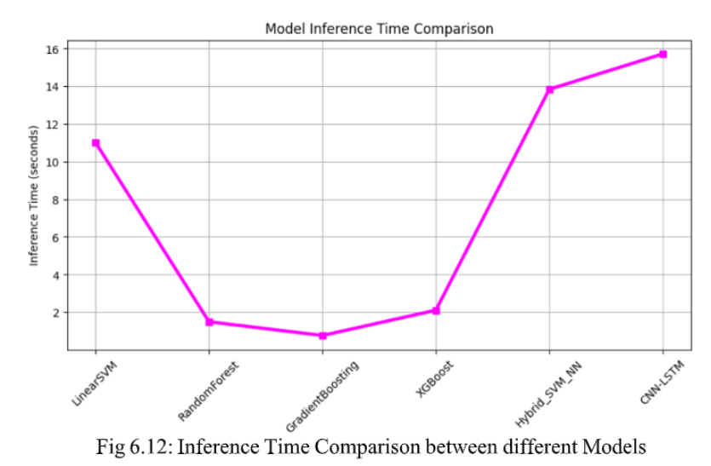
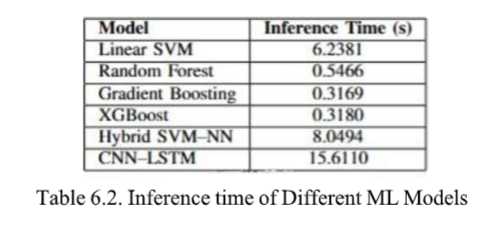

Slide 19
Future Work
In future we want to :
Synchronize all these systems together to ease up the quantum gravimetry based experiments.
We will also create a AI Assisted FeedBack Loop integrated with the Arty Z7 FPGA.

Slide 20
Thank You
Special Thanks to
CQuERE, TCG CREST
&
CSBS Department(IEM)

